Slide 1


Cloud platform solution introduction
Build you own IoT eco-system
Name: Shawn
Department: Technical support Department

Slide 2


Contents
01
02
03
About EZVIZ
Cloud platform solutions
Business model
Overview
EZVIZ cloud
Public cloud
Hybrid cloud
Private cloud
Monitoring
Smart home
ARC
AI scenarios

Slide 3
Contents
04
05
Certification & Data protection
Our Highlights

Slide 4
01
About EZVIZ

Slide 5




EZVIZ Histroy
v1.0 Public
APP、PC、Web
Cloud Storage Public
provide cloud video storage
Open platform
Public
OPEN
2013
2014
2015
AI
AI Technology
face、body、car...
DP1, a 2017 CES Innovation Awards Honoree, launched
Crossover -cooperation
cloud to cloud
2018
2017
2016

Slide 6

EZVIZ Cloud
Instant Alerts
100M+
sent daily
Real-Time Views
10M+
daily
CloudPlay
Subscription
100M+
Number of Video clips stored
on the cloud daily
AES 128-Bit Encryption
TLS Encryption Protocol
Multiple Authentication Steps
HTTPS+SSL Bank-Level Encryption
One device connects to one account only
6 EZVIZ Cloud regional servers,
covering the whole world
Protection of
Data and Privacy
+
+
+
50M
30M
10M
Security
Compliance
ISO 27001 Certified
CSA-STAR Certified
SOC 2 Type 1 Report completed
ISO 29151 Certified
User
accounts
Devices on
EZVIZ Cloud
Monthly
Active users
Last updated in 2019

Slide 7
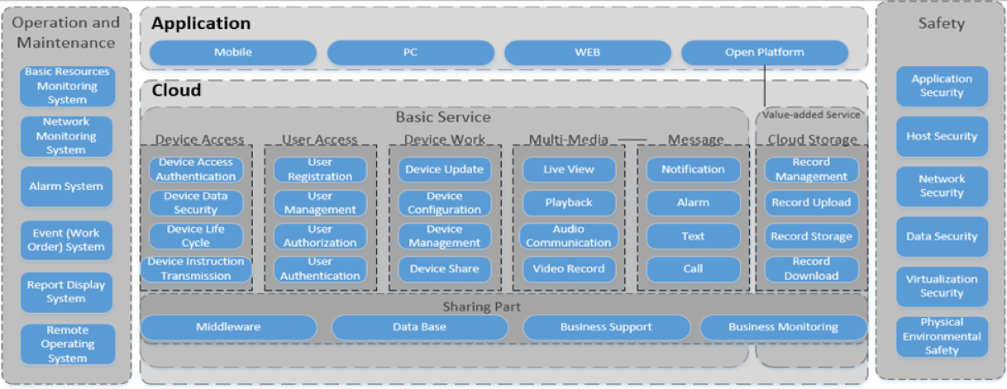
Cloud architecture

Slide 8
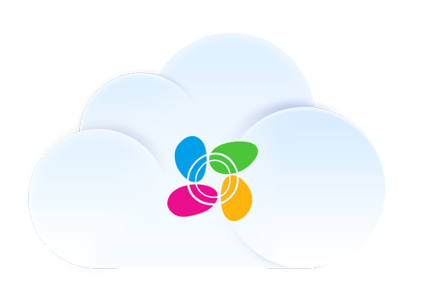
Open
MobileSDK
PC SDK
OAuth
Face
Body
3rd IOT SDK
RTMP
HLS
Interconnaction
Car Shape
Car
Number
VideoKit
Streaming
Cloud Storage
Message
Driver Behavior
Cloud
OpenAPI
Developer Service
Call Reminder
Push
Interconnaction
Customer
P2P/Relay
Firmware Update
Algorithm Training
AI
Device Access
stream
Cloud Storage
Video Call
3rd IOT
Device
IP Camera
Sensor
Peephole
Doorbell
Smart home
3rd device
Notes:
接入层：左到右，支持的设备包含家用到深度行业
中间：萤石云的基础服务
开放层4大能力开放：
棕色，视频流（实时视频、录像）开放、
绿色，互联互动（事件、控制）开放、
紫色，三方设备（3rd 设备，视频模组嵌入其他家电）开放、
蓝色，AI（视觉数据结构化）能力开放
接下来，展示我们最常见的两个集成场景

Slide 9
02
Cloud platform solutions

Slide 10
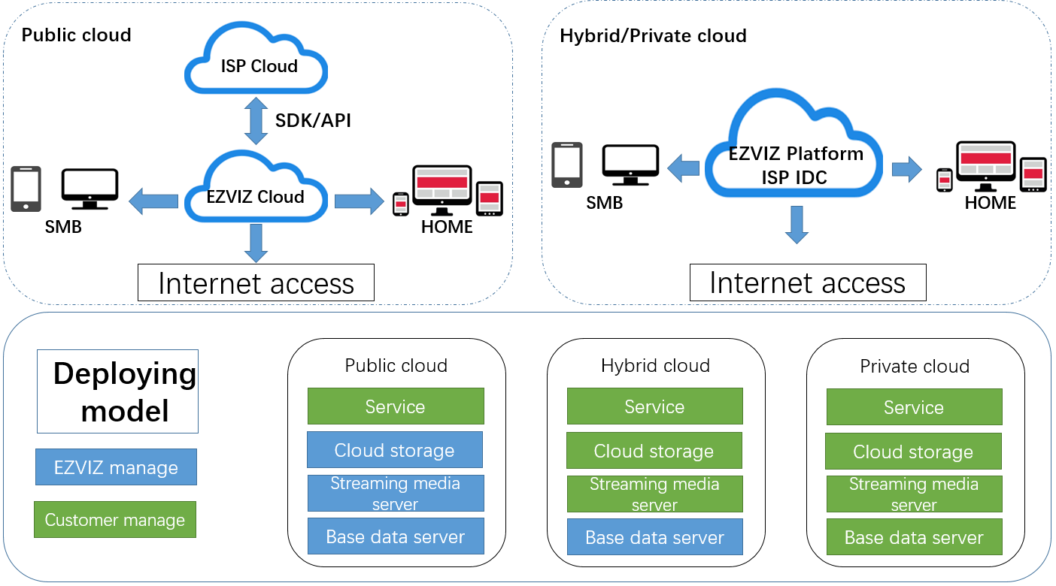
Service management

Slide 11

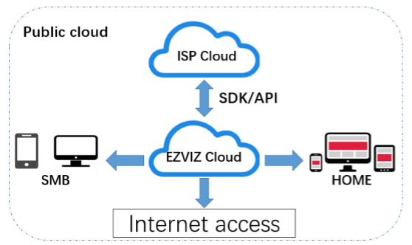
Public cloud
All the services provide to the partners are based on the EZVIZ’s existing cloud service. This method is apply to the partner who want to expand business and quickly launch new business.
Hardware：Baseline/Customized product
Software:：OEM-APP or App developed by
partner through EZVIZ’s API/SDK
SDK/API Guide: https://open.ys7.com/doc/en/
Security Video For Smart Life

Slide 12
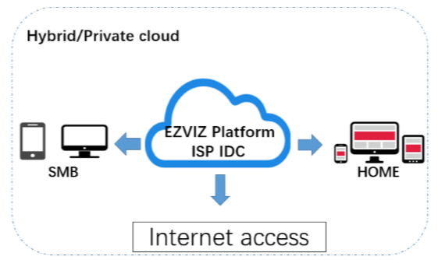
Hybrid cloud
In order to comply with local regulations, such as GDPR or user data privacy, some customers require video and user data to be stored locally. We deploy some services on clients, such as cloud storage services, streaming media services, or business support services.
Hardware：Customized product
Software:：OEM-APP or App developed by
partner through EZVIZ’s API/SDK
SDK/API Guide: https://open.ys7.com/doc/en/
Security Video For Smart Life

Slide 13
Private cloud
Designed for partner who want to control all data and all services.
Hardware：Customized product
Software:：OEM-APP or App developed by
partner through EZVIZ’s API/SDK
SDK/API Guide: https://open.ys7.com/doc/en/
Security Video For Smart Life

Slide 14
03
Business model

Slide 15
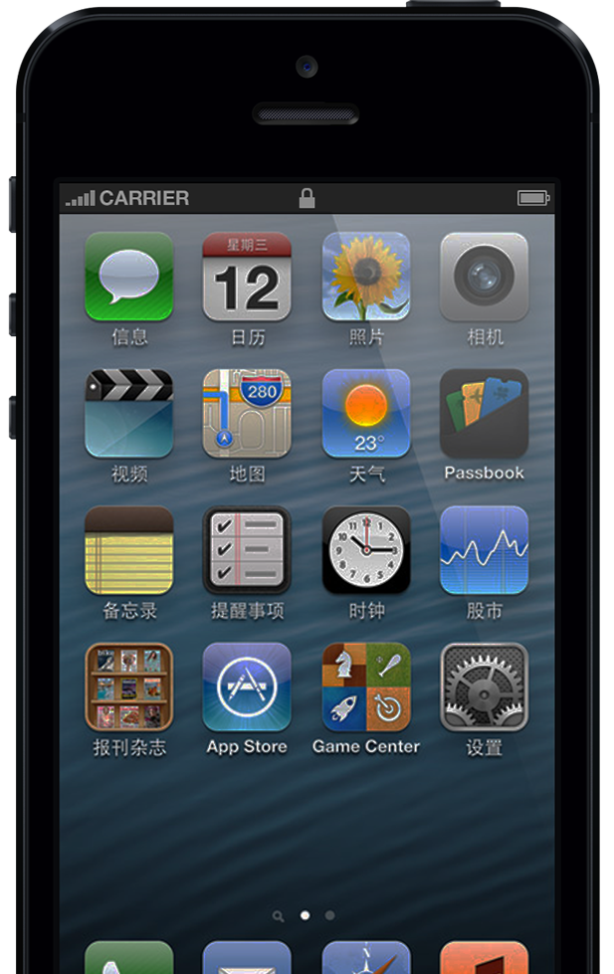
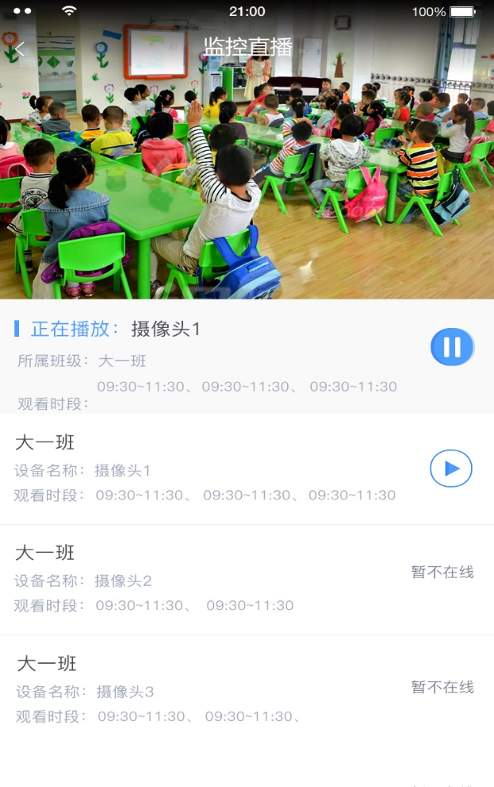
Business Model
Monitoring
1
Baby/ Agriculture/
Construction site/...
Demand
live-view
life Record

Slide 16
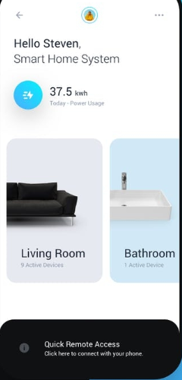
Business Model
Smart Home
2
Smart Home
Demand
live-view
Interconnection
Security life
Real-time Voicetalk

Slide 17
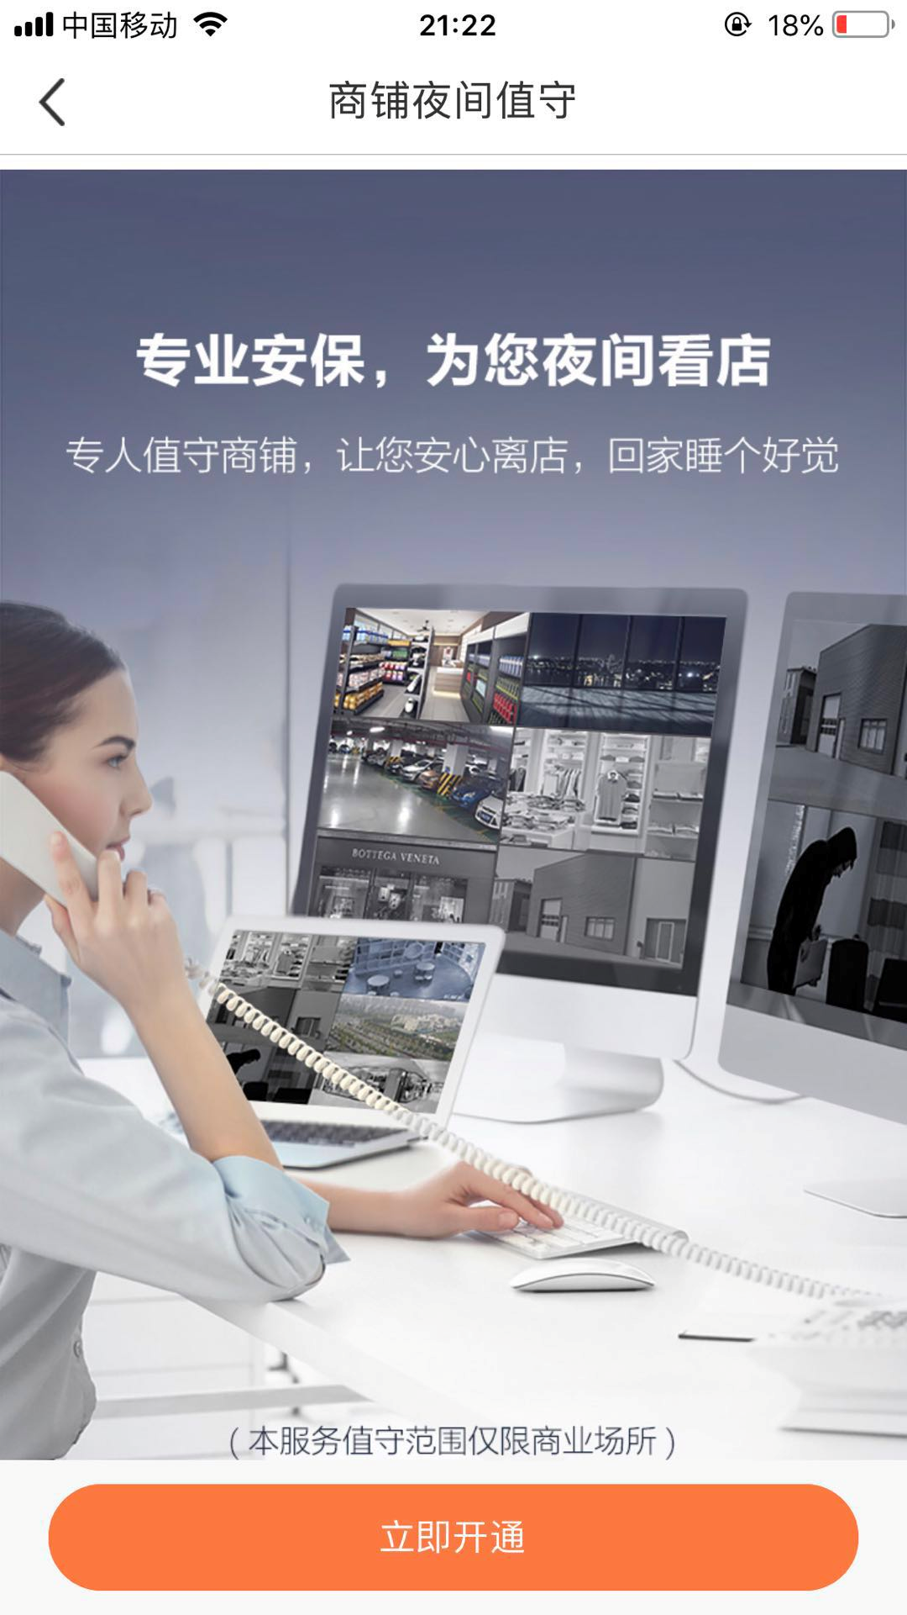
Business Model
Alarm Receiving Center
3
ARC
Demand
live-view
Alarm Video Playback
Alarm Notification

Slide 18

Business Model
Al technology for shop
3
Smart shop
Demand
Face/human feature extraction
Regular visitors to identify
Customer group attribute analysis

Slide 19
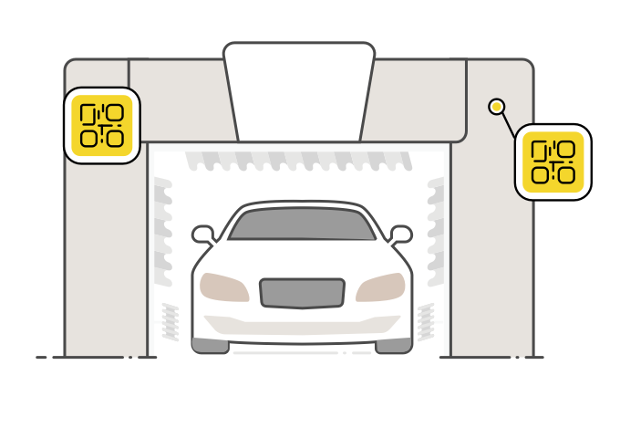

Business Model
Al technology for service
4
Self-service Car wash
Demand
Car shape/Car number recognition
Queuing congestion recognition

Slide 20
04
Security and data protection
Notes:
EZVIZ follows international security standards and industry requirements and takes them as the internal control framework.
EZVIZ has passed certification of many agencies globally, and now serves as an IoT solution provider with the most comprehensive certificates over the world.
See the following for our certification

Slide 21
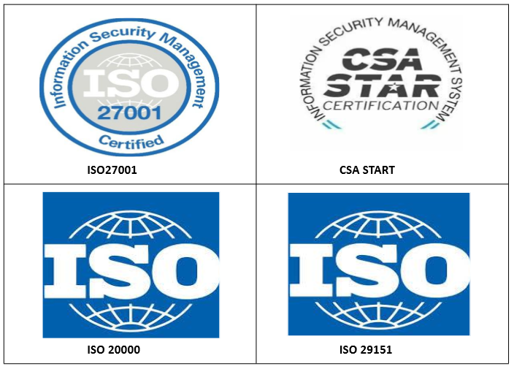
Certification
Certification we have:
ISO27001
ISO20000
ISO29151
CSA START
SOC2TypeI
Security Video For Smart Life
Notes:
ISO27001 – global security standard
ISO20000 - IT Service Management
ISO29151 - which is an international standard specifically for the protection of personal information.
CSA STAR - is a security rating and certification system for cloud services, Certified companies indicate that their system have fully met the security control requirements.
SOC2TypeI - The Service Organization Control (SOC) 2 verifies that EZVIZ passed a strict audit of its internal controls, meeting the security, availability, confidentiality, and privacy standards set by American Institute of CPAs (AICPA).

Slide 22
Data protection
Wide Area Network:
Data Encryption
Identity recognition
Dynamic key
Channel Encryption.
Secure chips
Local area network:
Data Encryption
Dynamic Key
Security Video For Smart Life

Slide 23
05
Our Highlights
Notes:
EZVIZ follows international security standards and industry requirements and takes them as the internal control framework.
EZVIZ has passed certification of many agencies globally, and now serves as an IoT solution provider with the most comprehensive certificates over the world.
See the following for our certification

Slide 24
Highlights
Best Experience
EZVIZ has “Smart device + Cloud service”intergration solution

Slide 25
Highlights
Full link Encryption
The default equipped with encryption chip, video from the front-end ports to the client, all content/link encryption
ISO/IEC 27001、SOC2、CSA-STAR、ISO 29151

Slide 26
Highlights
Global Cloud Service
EZVIZ Can provide services for global customers, with eight center machine room, 20 + engine room

Slide 27
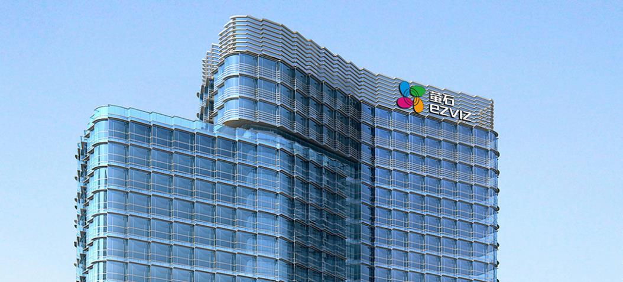




THANK YOU
www.ezvizlife.com
Find us on: EZVIZ Global

